Slide 1
High Frequency Radio Team
(HFRT)
Skill Level 1
Place Longwire Antenna into Service

Slide 2
Purpose: The following slides gives basic instruction in the following
Skill Level 1 High Frequency Radio Team (HFRT) tasks as identified in
The HFRT Training and Evaluation Outline (T&EO):
Place longwire antenna into service.
Conditions: You are located in the desired position and with
the necessary equipment to erect the longwire antenna.
Standard: The team after, completing the block of instruction, will
safely set up the antenna within 20 minutes.

Slide 3
Safety Briefing:
Never erect antennas less than 2 times its length close to energized power lines.
Never touch or be in close proximity to antennas when transmitting or burns could result.
Always ground equipment using proper grounding techniques.

Slide 4
General Antenna Siting Requirements
In addition to the safety requirement of staying away from energized power lines, be cognizant of the following:
Wide open areas will give better reception.
Closer proximity to power lines will increase possibility of interference.
The closer you are to buildings will reduce reception.
The distance your antenna can be away from the radio is determined by the length of your antenna coax and your tuner cables.
Site your antenna so your radio will have shelter from elements and electrical power (if available).

Slide 5
A Word about Longwire Antennas
Longwire antennas may be erected in many different ways with books being written about types of longwire antennas. You can erect them vertically, sloping down from a high point, as a “V” either with the V up or down; to name a few and all have advantages and disadvantages. This task will show you how to erect a “L” antenna which is capable of the NVIS (Near Vertical Incidence Skywave) communications that the VDF requires. All VDF members are encouraged to educate themselves and to experiment with the other types of antennas.

Slide 6
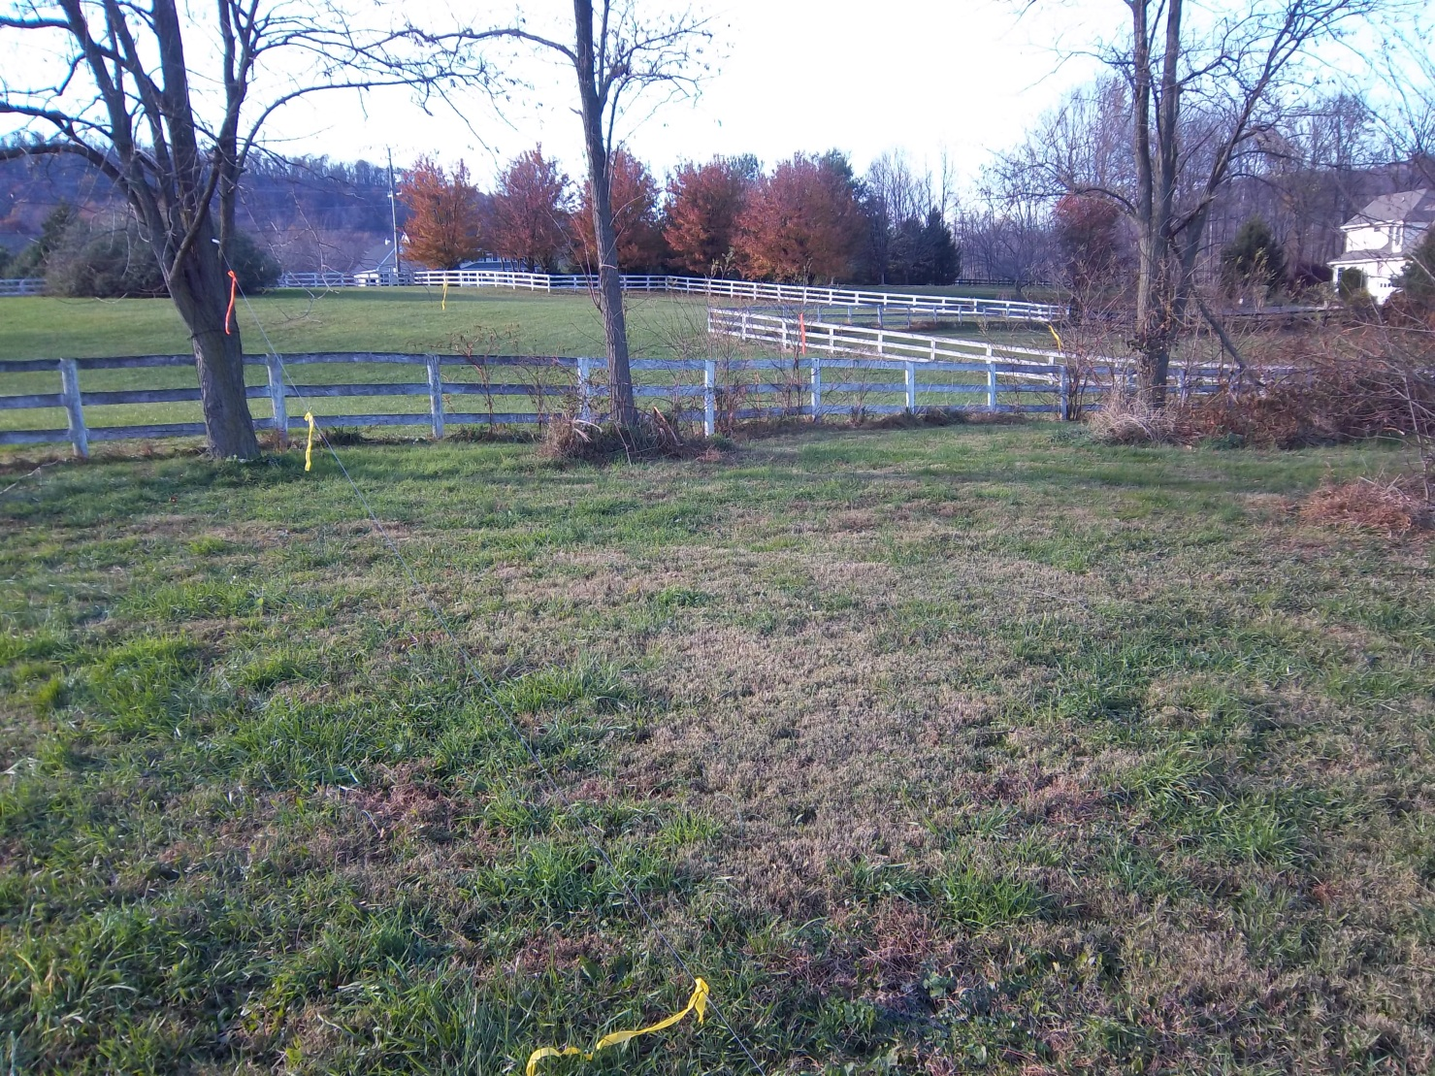
Step 1
Determine position of antenna siting.

Slide 7
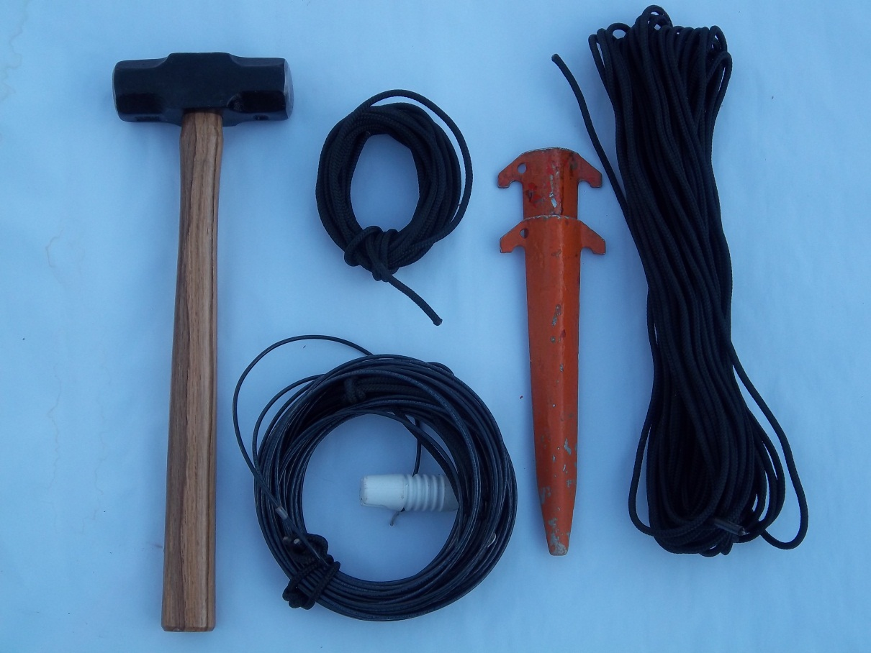
Hammer
Antenna
Cord
Stakes
Step 2
Locate the materials you will be using. Gather these in your antenna location.

Slide 8
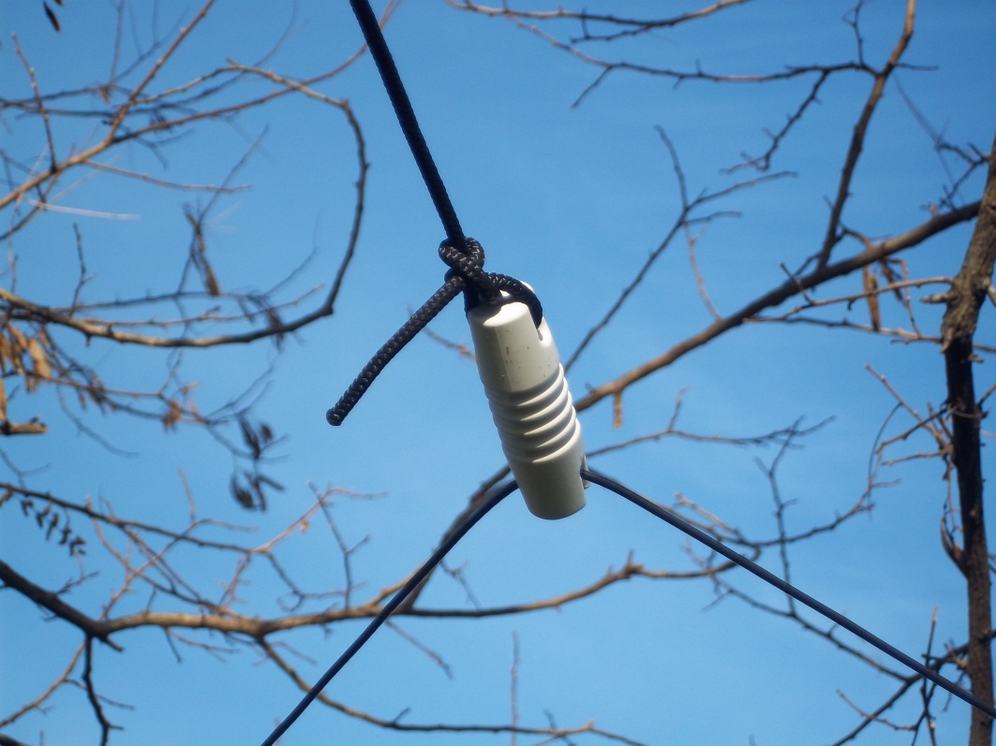
Step 3
Unroll antenna, paying strict attention that it does not kink or knot itself.
Divide the antenna into half and place the insulator at the midpoint.
Tie the short cord to the tree/support.
Tie the other end of the short cord to the insulator.

Slide 9
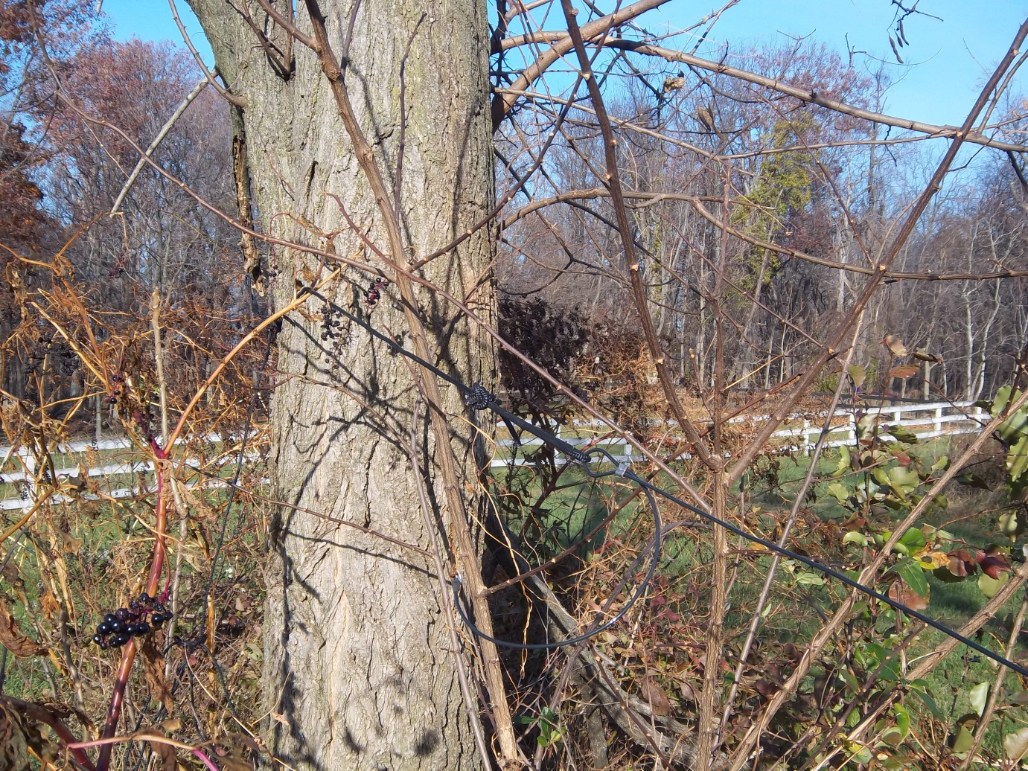
Step 4
Tie one antenna end to a tree/support with the long cord. Note that this
antenna does not have to
be high off the ground.

Slide 10
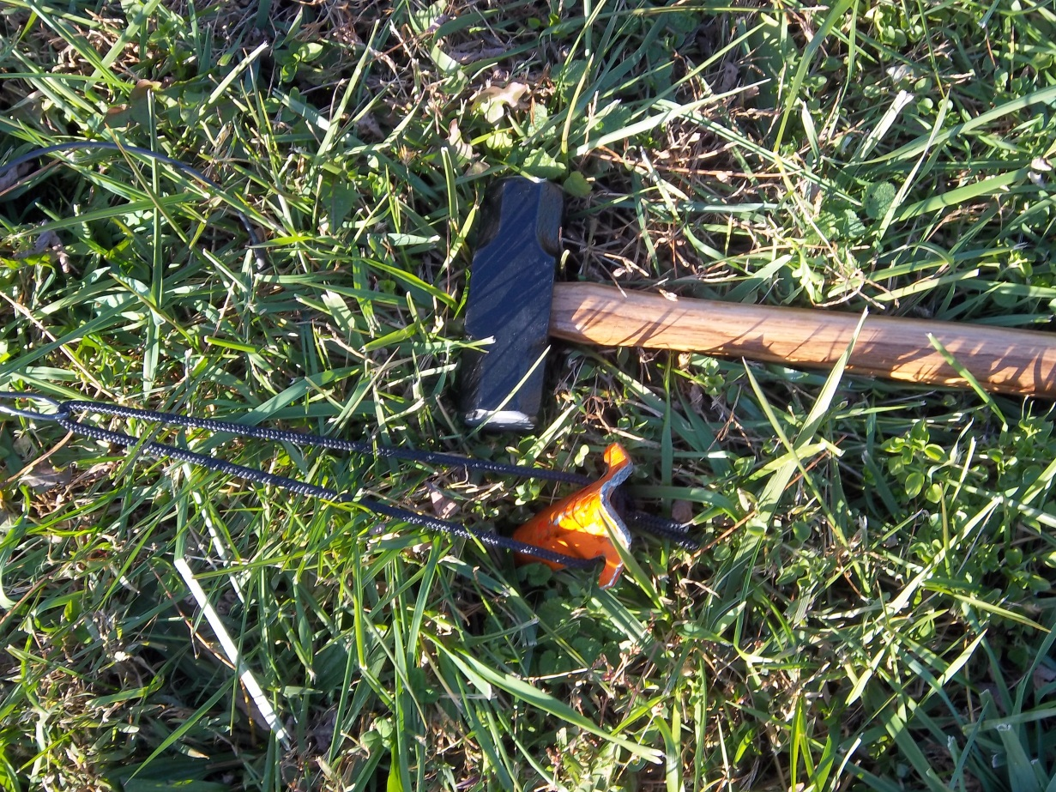
Step 5
Stretch out the remaining “L” segment, again making sure that it is at right angles to the already established leg. Secure this leg with a stake . Attach the rope to the stake.
Tip: you can use a grounding stake as the antenna stake if it is secure enough!

Slide 11
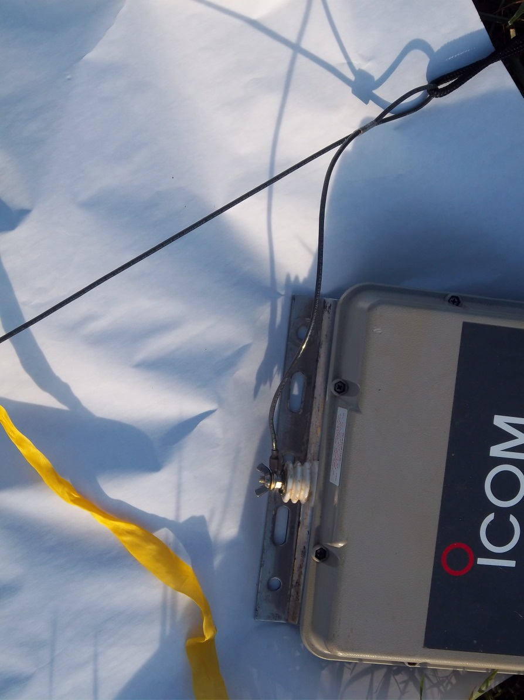
Step 6
Connect the free end connector to the tuner high tension connector.

Slide 12
Step 7
Warning
flags
Warning flags
Tie caution tape to the antenna leads to prevent someone from walking into the antenna. At night use chem lights if you have them available.

Slide 13
To Secure Antenna
Remove tuner wire.
Remove rope securing the antenna.
Carefully roll up the antenna wire.
Remove the stake and the mounting ropes.
Secure all items in the transport case.
Double check that you didn’t leave anything behind.

